Slide 1
Clinical interpretation of genomic variants
Harriet Feilotter, PhD, FCCMG, FACMG
Professor, Dept of Pathology and Molecular Medicine, Queen’s U
Director, Molecular Genetics, KHSC

Slide 2
Disclosures
I have the following financial relationships to disclose:
Consultant for Janssen, Roche, Astra Zeneca, Precision Rx, Novartis, EMD Serono, Pfizer, Bayer
Research Support from Astra Zeneca, Roche, EMD Serono, Amgen, Pfizer, Canexia Health
I will not discuss off label use and/or investigational use in my presentation.

Slide 3
Learning objectives
Define and describe different types of molecular oncology biomarkers
Describe the difference in approach between characterization of a germline and a somatic biomarker
List the important considerations when ascribing clinical relevance to a biomarker

Slide 4
Specific take home messages
Defining exactly which biomarker you are dealing with is critical to avoid confusion, discordance and errors
To define a mutation, you must define the version of the gene you are aligning against
Once a mutation has been identified, you must interpret the clinical or biological impact of the variant in the context of the disease/sample and what you know about the mutation profile of that gene
Know your biomarker and your assay- if you are looking for activating mutations of an oncogene, know the range of what those might be and know whether your assay will detect all of them

Slide 5
Classifying genomic biomarkers
Classify by type of biomarker
Classify by distribution in affected individual
Classify by type of mutation
Classify by the type of gene
Classify by type of disease
Classify by type of information available

Slide 6
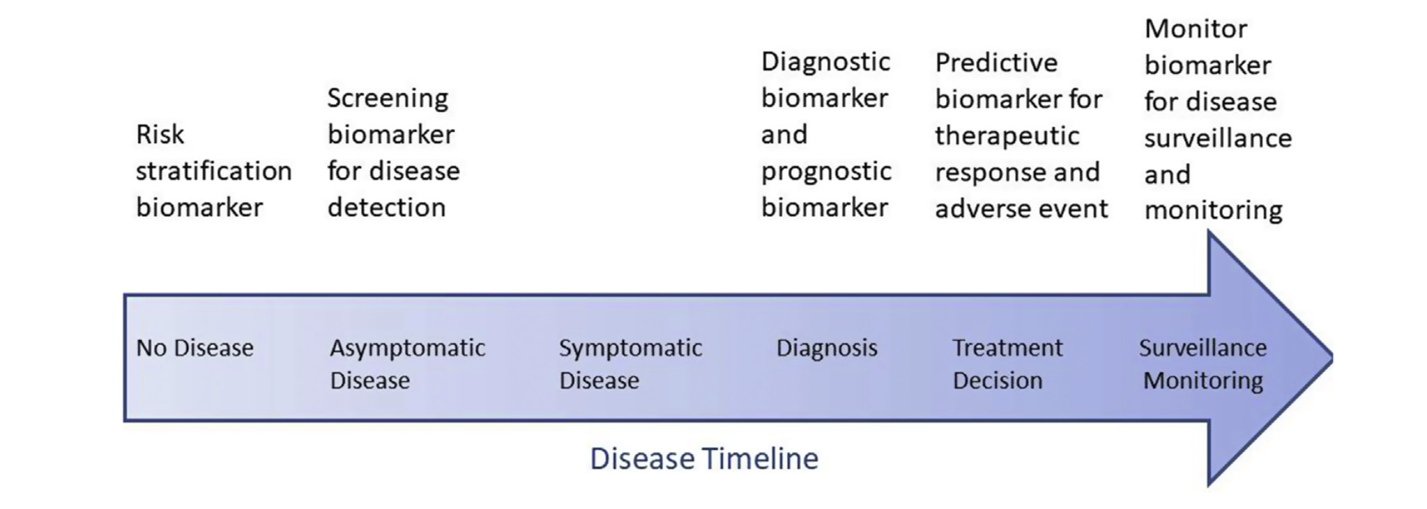
Types of molecular oncology biomarkers
Taken from https://doi.org/10.1016/j.jtho.2021.01.1616
Notes:
DNA only for this session

Slide 7
Categories of DNA mutations- what and where
Silent/synonymous
Missense/non-synonymous
Nonsense
Regulatory variants
RNA processing
Splice site variants
Small insertion
Small deletion
Larger gene deletions, inversions, fusions, duplications
Repeat expansions
LINE/Alu insertion
Chromosome arm deletions, duplications, translocations
Aneuploidy, polyploidy

Slide 8
Germline vs somatic variants
In a clinical trial, could be important to know whether a variant is germline or somatic
One way to determine this is to sequence both a normal and a tumour sample
If this is not possible, one has to infer this information
https://gatkforums.broadinstitute.org/gatk/discussion/11127/somatic-calling-is-not-simply-a-difference-between-two-callsets

Slide 9
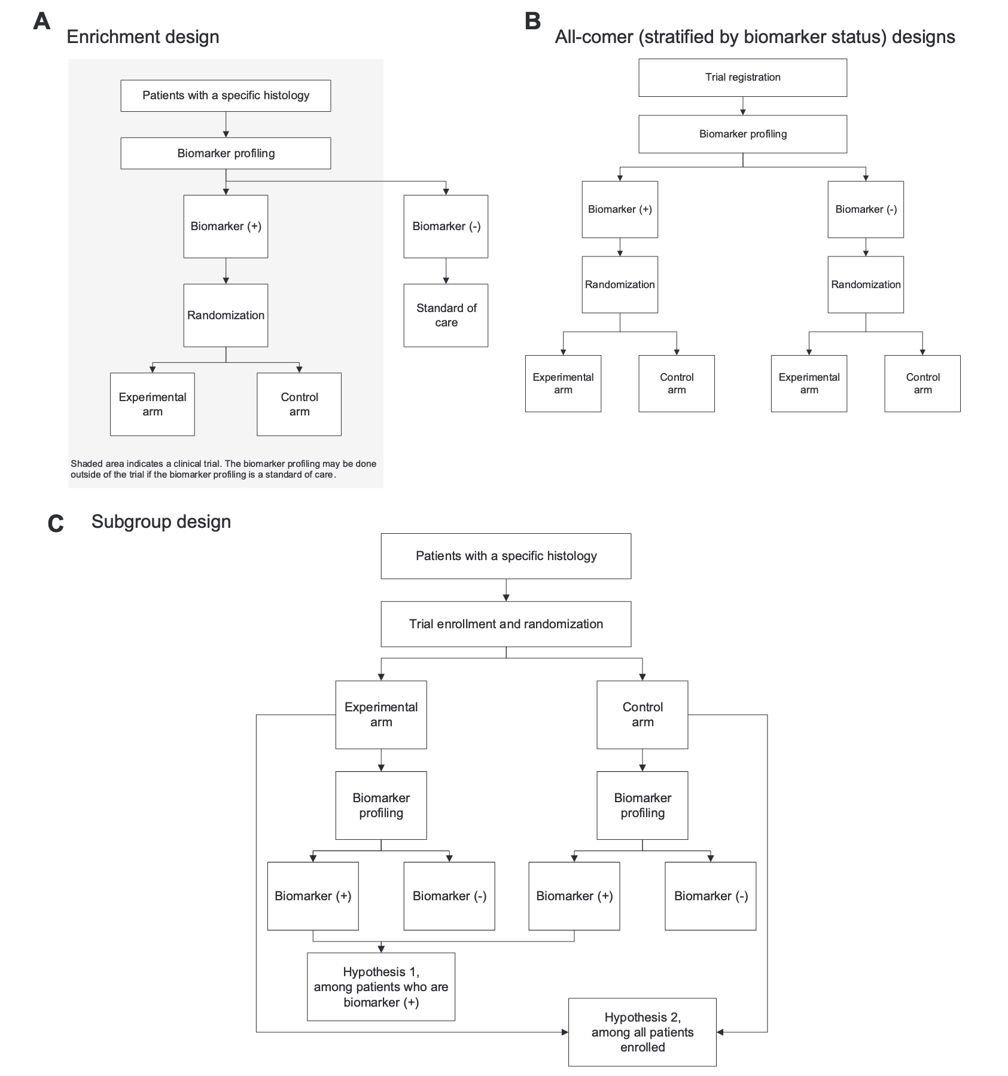
Biomarkers in clinical trials
Many nuances in how biomarkers can be classified or categorized
Clinical trials that incorporate genomic biomarkers are increasing in number
How are these nuances handled in that setting?
Taken from https://doi.org/10.1016/j.jtho.2021.01.1616

Slide 10
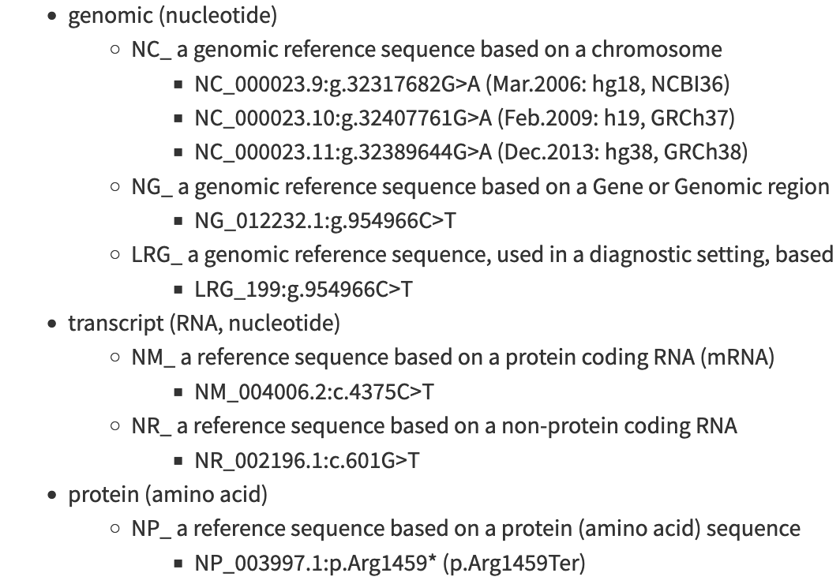
Before you understand Biomarker +, have to know how to talk about genomic variants
BE CLEAR ABOUT WHICH GENE OR PROTEIN IS THE BIOMARKER OF INTEREST- Standardized nomenclature rules will help with this.
Must name genes and gene products unambiguously to avoid confusion
At the protein level, the use of “common” names is rampant and unlikely to change in the near future- eg PD-1 is the product of PDCD1 but is also used as an alias for SNCA
At the nucleotide level, it’s just as important to be specific
Many isoforms or variants of genes have been deposited into the databanks
If you don’t specify which one you are talking about, mistakes will happen

Slide 11
Gene level nomenclature
NM_000546.4(TP53):c.215C>G(p.Pro72Arg)
NM_001276760.1(TP53):c.98C>G(p.Pro33Arg)
NM_000546.5- refers to the exact version of the gene that has been deposited in a public database
TP53- accepted gene name- should be italisized to differentiate from protein
c.215C>G- nucleotide change, counting from the first A of the starting methionine, which is called “1”
p.Pro72Arg- corresponding protein change

Slide 12
What is biomarker positive?
Imagine a clinical trial that stratifies on KRAS status
What is the biomarker? KRAS? A KRAS variant? A specific activity of the KRAS protein?
Need to understand the impact of the variant that results in a positive call
In the case of KRAS, often looking at gain of function mutations that enhance the GTPase activity

Slide 13
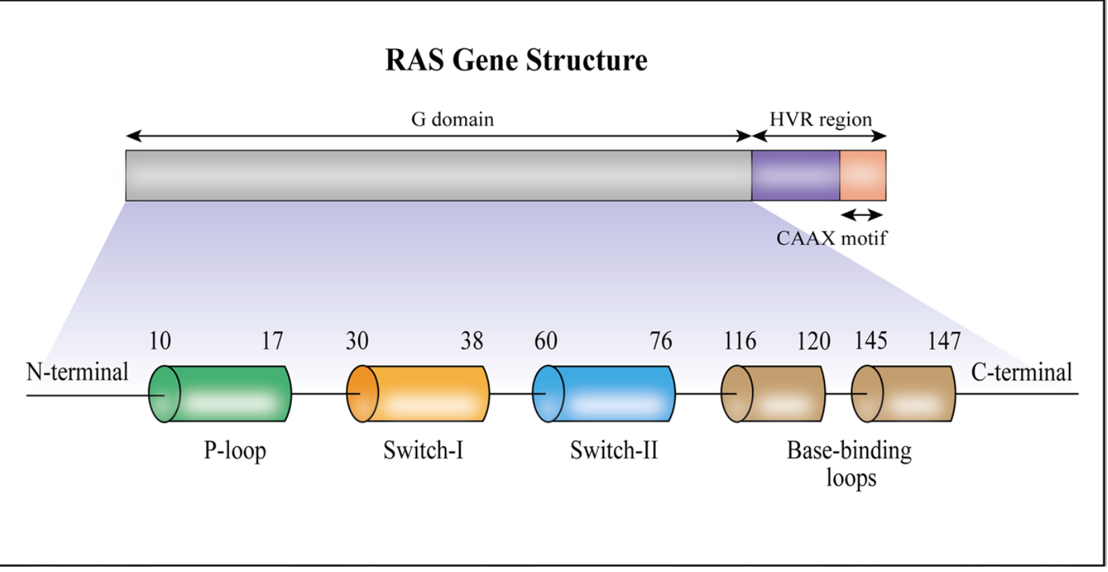
RAS proteins
4 major RAS isoforms (KRAS4A, KRAS4B, HRAS, NRAS)
First 165 amino acids highly conserved and form the G domain
Gain of function or activating mutations result in prolonged active state- GTP bound
19% of cancer patients have activating KRAS mutations
Taken from Kwan et al J Exp Clin Canc Res 2022

Slide 14
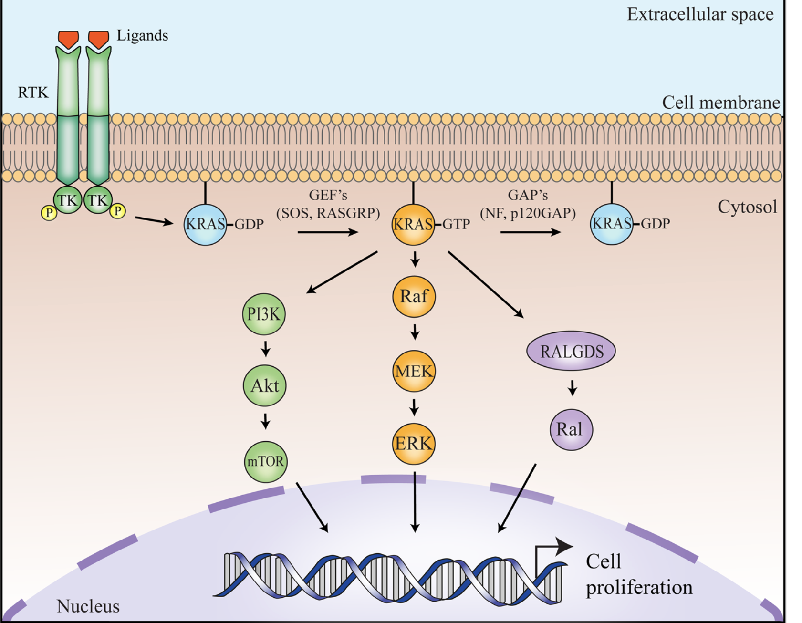
What is an activating KRAS mutation?
Mutating codon 12 or 13 results in a steric block that prevents the GAPs from entering the GTPase site
Mutating codon 61 abolishes the GTP hydrolysis mechanism
G12C, G12D, G13D- high intrinsic GTPase activity
G12A, G12C, G13D, Q61L- high RAF binding affinity
G12A, G12R, G12V, Q61L, Q61H- low intrinsic GTPase activity
G12R, G12V, G12D- low RAF binding affinity

Slide 15
The assay to measure the biomarker matters
ASSAY DETECTS… | Mutation negative | Mutation positive
KRAS codon 12 variants | 80 | 20
KRAS codon 12/13 variants | 79 | 21
KRAS codon 12, 13, 117, 61, 146 variants | 75 | 25
Complete scanning of KRAS | 70 | 30
Add to this the fact that different RAS genes are preferentially mutated in different tumours (KRAS predominant in colon, pancreatic, lung, cholangio; NRAS for melanoma, myeloma, CML, AML and HRAS head and neck and bladder) and the exact specifications of the assay become even more important

Slide 16
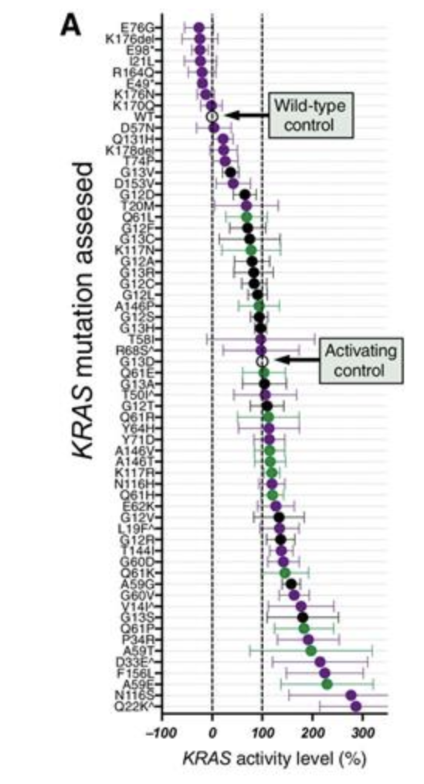
KRAS variants overall
About 1.2% of KRAS variant identified in a study of ~9500 CRC patients were considered atypical
~10% of those co-occurred with a common activating KRAS mutation
Taken from Loree et al 2021 ClinCanc Res 27: 4587

Slide 17
KRAS scanning
Assume your assay will identify ANY mutations within the coding region of KRAS
What if you identify a mutation that is not one of the common known gain of function mutations?
NM_033360.3(KRAS).c.491G>A(p.Arg164Gln)

Slide 18
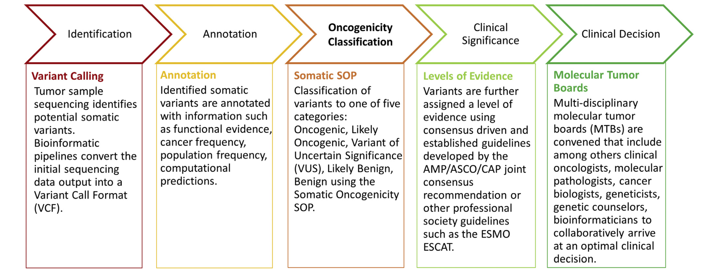
Somatic variant interpretation
Taken from Genetics in Medicine 2022 24: 986

Slide 19
Variant Interpretation Classifications Germline/Somatic Variants
Germline
Pathogenic
Likely Pathogenic
Uncertain Significance (VUS)
Likely Benign
Benign
Somatic
Oncogenic
Likely Oncogenic
Uncertain Significance (VUS)
Likely Benign
Benign
Notes:
VUS – also exists in somatic tumor analysis but impact is different in inherited cancer - increased uncertainty for relatives with the VUS

Slide 20
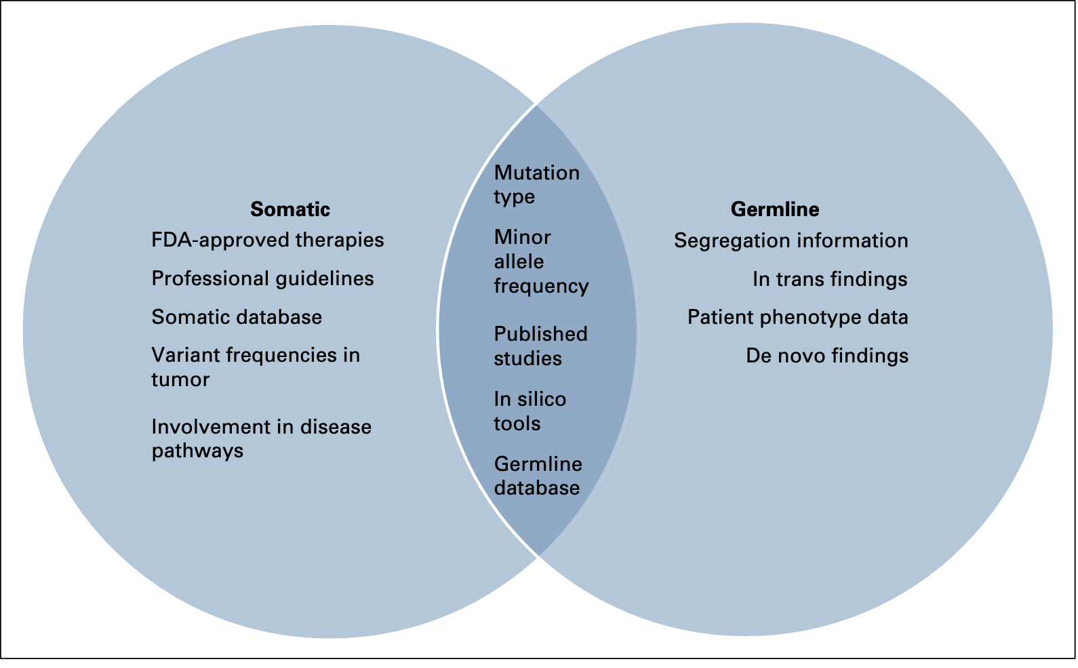
Variant interpretation from scratch
Taken from Moody et al 2019 JCO Precis Oncol

Slide 21
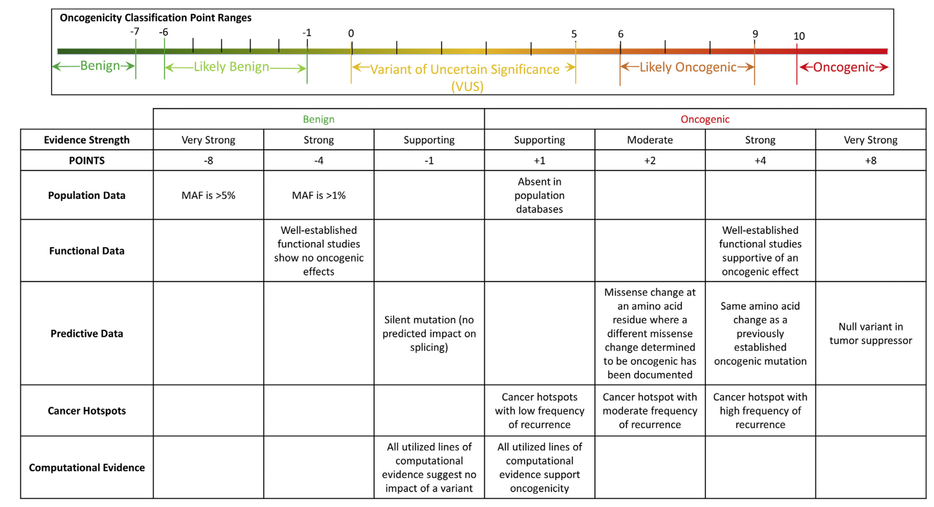
Taken from Genetics in Medicine 2022 24: 986

Slide 22
AMP/ASCO/CAP Interpretation scheme
Taken from Li et al 2017 JMD 19:4

Slide 23
NM_033360.3(KRAS).c. 491G>A(p.Arg164Gln)
Not one of the known mutations in KRAS
Using the evidence guideline, find a couple of functional studies- one shows mouse fibroblasts carrying this variant show foci formation similar to wildtype; another suggests slight increase in MAPK signaling but many of the cell lines tested also carried additional activating KRAS mutations
No predictive data
Not a hotspot
Computational tools predict deleterious
End up with a VUS call

Slide 24
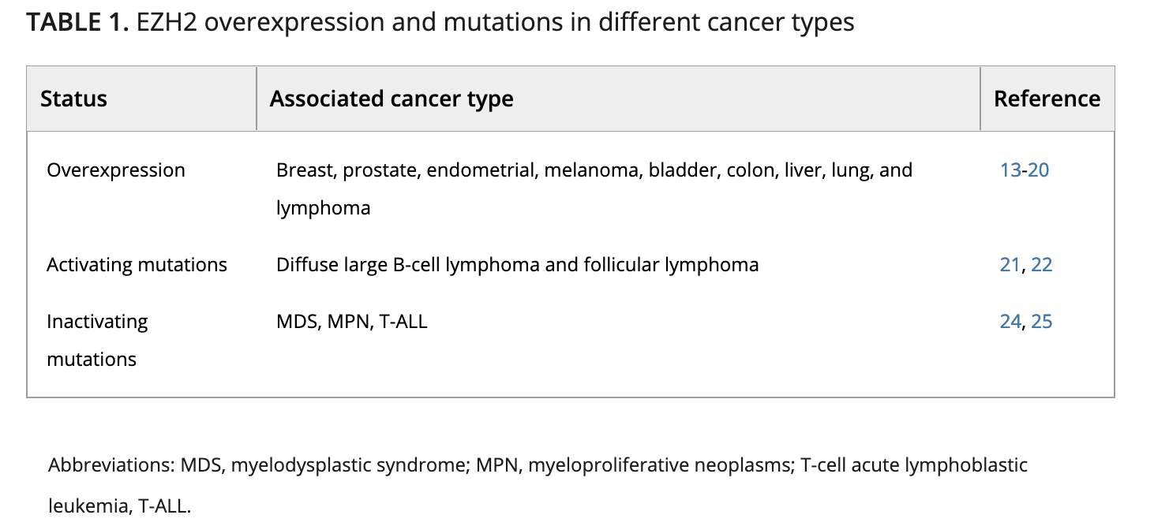
Mutations may also have cell-context interpretations
NM_004333.4(BRAF):c.1799T>A(p.Val600Glu)
Taken from
https://doi.org/10.1111/cas.14840

Slide 25
Hereditary and somatic interpretations of the same mutations
More and more, the same genes are being assessed in both the germline and somatic context
In particular, genes like BRCA1, BRCA2, CHEK2, PALB2, ATM, MLH1, MSH2, PMS2, MSH6
Study looking at single nucleotide variants reported in a variety of tumours and comparing those results to the germline variant interpretations

Slide 26
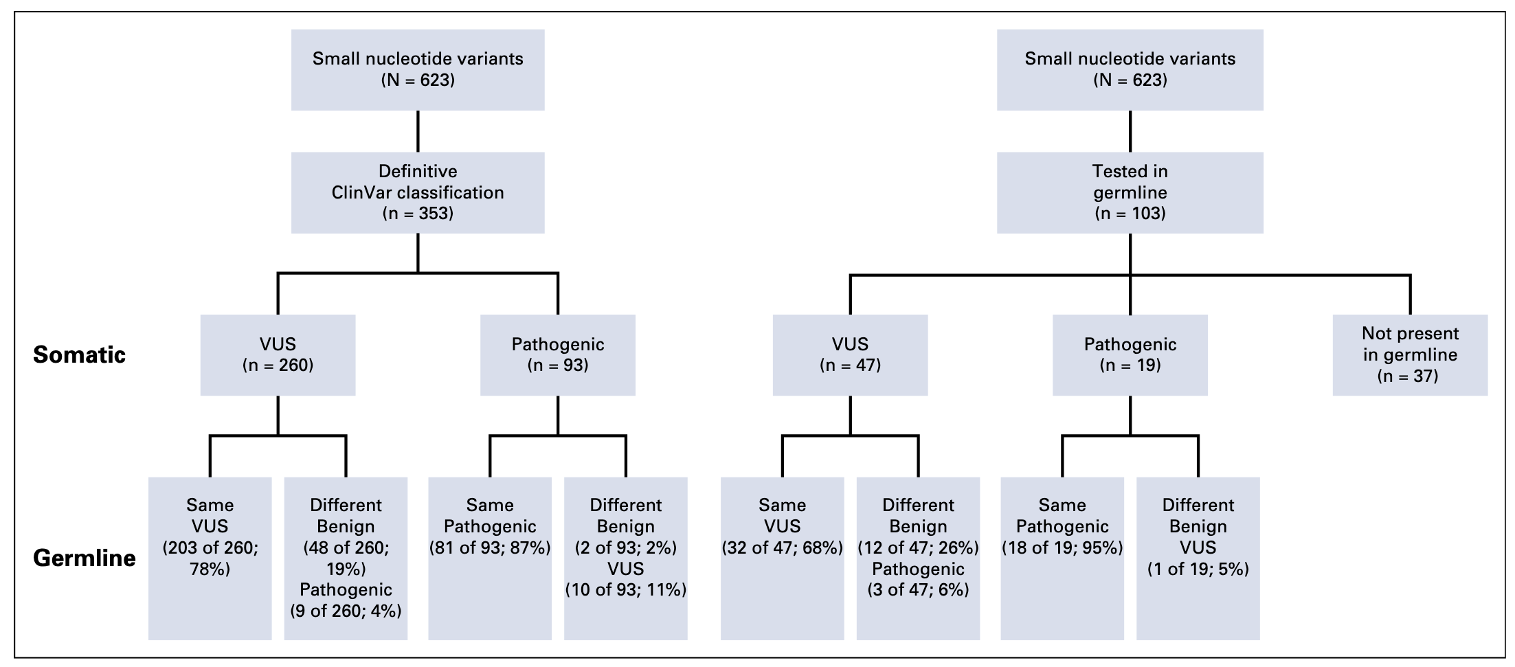
Taken from Moody et al 2019 JCO Precis Oncol

Slide 27
NM_000059.2(BRCA2):c.9976A>T(p.Lys3326*)
Truncating variant- in a disease where this is a known mechanism -but the variant is in the last exon, towards the end- the last amino acid should be 3419
Population data shows that the variant has been identified across all populations at a frequency of ~0.6%- much higher than the frequency of hereditary breast/ovarian cancer syndrome
In some populations, frequency >1%, defining this as a polymorphism
More recently, literature shows this variant impacts HR ability, although does not abolish it
May be associated with specific cancers (i.e. not necessarily breast or ovarian)
Large study of ~400,000 cases and controls suggests it is associated with cancers with environmental genotoxic risk factors

Slide 28
Specific take home messages
Defining exactly which biomarker you are dealing with is critical to avoid confusion, discordance and errors
To define a mutation, you must define the version of the gene you are aligning against
Once a mutation has been identified, you must interpret the clinical or biological impact of the variant in the context of the disease/sample and what you know about the mutation profile of that gene
Know your biomarker and your assay- if you are looking for activating mutations of an oncogene, know the range of what those might be and know whether your assay will detect all of them

